Slide 1
Let's play a game ( the numbers game)
https://www.wordwall.net/play/5453/404/527

Slide 2
Help your friend :

Slide 3
Lets play the directions game ☺
Please help your friend

Slide 4
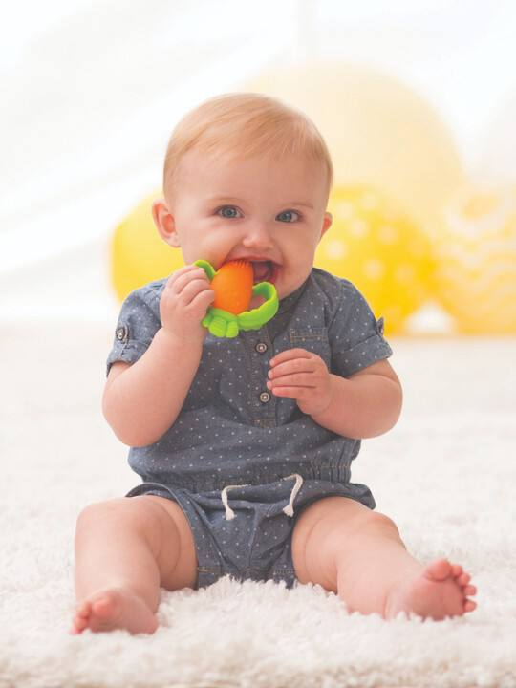

Slide 5
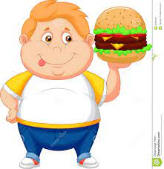

Slide 6
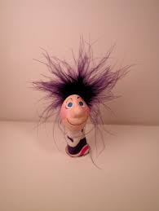

Slide 8
Jump three
times

Slide 9
Show me
Something yellow

Slide 10
Guess which cartoon:

Slide 11
Listen carefully

Slide 12
Guess who :

Slide 13
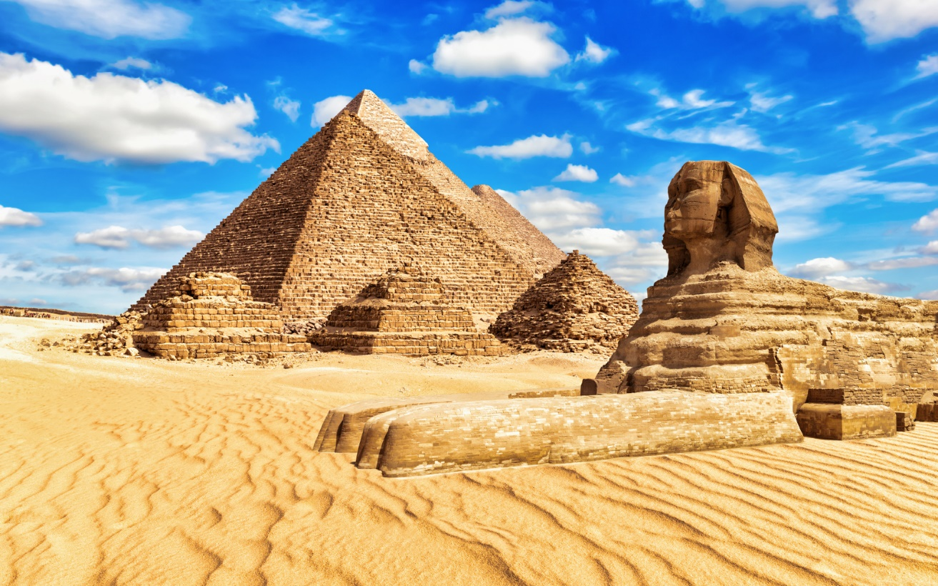
Which country?

Slide 14
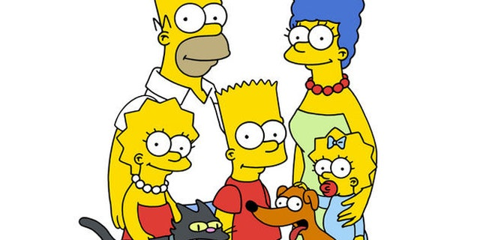
Name this cartoon

Slide 16
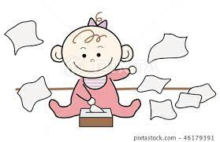
Draw something you used to do as a baby

Slide 17
Answer you worksheets

Slide 19
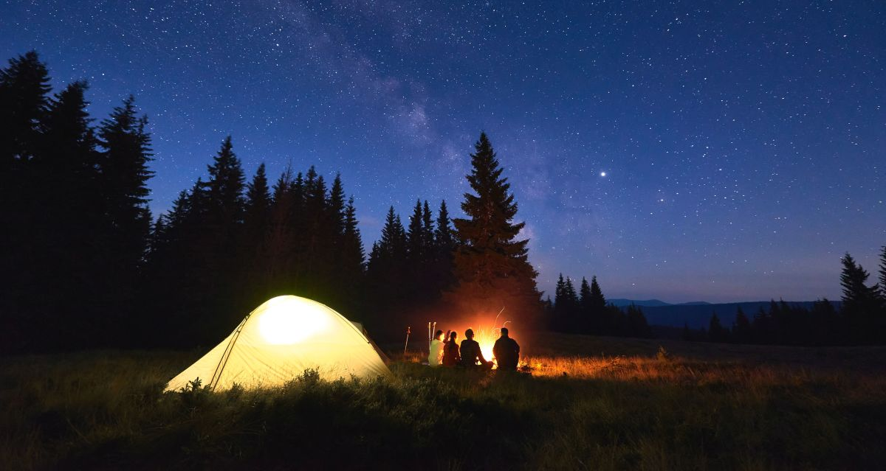

Slide 21
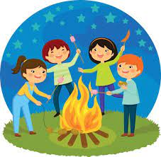
You mustn't play with fire.

Slide 22
Choose should or shouldn’t to complete the sentences

Slide 23
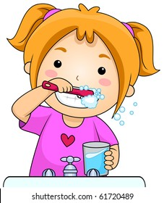
Write about two things you
didn’t have to do when you were a baby .
1- I didn’t have to ____________ .
2- I didn’t have to ____________.

Slide 24
See you next class ☺

Slide 25
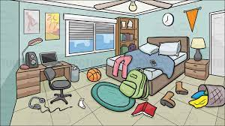

Slide 26
